Slide 1
Waveband switching

Slide 2
Waveband switching
WBS
  In GMPLS networks, underlying network nodes need to support multiple switching granularities
  Therefore, ordinary wavelength-switching OXCs must be upgraded to support multiple switching granularities => multigranularity OXCs (MG-OXCs)
  MG-OXCs hold great promise to reduce complexity & cost of OXCs significantly by switching fibers & wavebands as an entity => waveband switching (WBS)
  WBS groups several wavelengths together as waveband & switches it optically using single input/output port instead of multiple ports, one per wavelength
  WBS helps reduce port count, control complexity, and cost of photonic & optical cross-connects

Slide 3
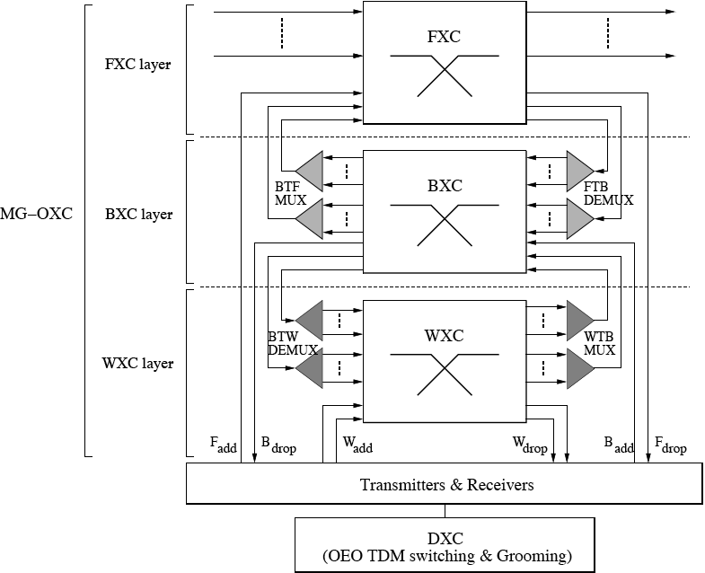
Waveband switching
Multilayer MG-OXC

Slide 4
Waveband switching
Multilayer MG-OXC
  Switches & adds/drops traffic at multiple granularity levels
  Traffic shifted between granularity levels by using appropriate multiplexers & demultiplexers
  Additional DXC with OEO conversion used to perform subwavelength switching (e.g., TDM switching, grooming)
  Benefits
    Fibers & wavebands that carry bypass traffic are not (de)multiplexed and can be switched as an entity
    Only fibers & wavebands that need to drop/add local traffic are (de)multiplexed
  Drawbacks
    Additional (de)multiplexers required
    Deteriorated optical signal quality

Slide 5
Waveband switching
Single-layer MG-OXC
  In single-layer MG-OXC, all lightpaths traverse only a single switch fabric
  Single-layer MG-OXC mitigates shortcomings of multilayer MG-OXC
  Besides complexity, cost, and signal quality issues, choice between single-layer & multilayer MG-OXCs is determined by given traffic loads
    Static traffic
      Single-layer MG-OXC provides greater reduction in size
    Dynamic traffic
      Multilayer MG-OXC provides greater reduction in size

Slide 6
Waveband switching
Waveband grouping
  Waveband grouping strategies
    Find out how many & which wavelengths need to be grouped together into a single waveband in order to satisfy certain performance metrics
    Classification
      End-to-end waveband grouping
      Intermediate waveband grouping
    In general, intermediate waveband grouping strategies achieve higher cost savings

Slide 7
Waveband switching
RWA
  Routing and wavelength assignment (RWA) problem in WBS networks using MG-OXCs is in general more involved than in wavelength-switching networks with ordinary OXCs
  Apart from wavelength continuity constraint, RWA problem must take into account further constraints
  Several new RWA-related problems in WBS networks
    Routing and wavelength/tunnel assignment (RWTA)
    RWA+
    Routing, wavelength assignment, and waveband assignment (RWWBA)

Slide 8
Waveband switching
RWTA
  Apart from RWA, tunnel assignment is another important problem in WBS networks => RWTA problem
  Definition of tunnel
    A group of consecutive wavelength channels grouped & switched together
      Waveband tunnel: Contains multiple consecutive wavelengths
      Fiber tunnel: Consists of multiple waveband tunnels
  RWTA problem deals with establishing & switching tunnels in mesh WBS networks and routing lightpaths through them
  Tunnel set-up recommendations
    Use existing fiber & waveband tunnels for lightpath set-up
    If no appropriate tunnels exist, give priority to creating new fiber tunnel over creating new waveband tunnels
    If no tunnels can be newly established, lightpath is set up without any tunnels by solving conventional RWA problem

Slide 9
Waveband switching
RWA+
  Combinatorial optimization problem with the objective to minimize bottleneck link utilization of mesh WBS networks with fiber, waveband, and wavelength switching capabilities
  Outperforms conventional linear programming approaches in accuracy & computational time complexity
RWWBA
  Addresses optimal routing & wavelength/waveband assignment in mesh WDM networks with wavelength & waveband switching capabilities
  Aims at maximizing cost savings & minimizing blocking probability
  Can be solved by using intermediate waveband switching algorithm to control creation of new waveband routes & determine waveband grouping node and waveband disaggregating node along selected route

Slide 10
Waveband switching
TDM switching & grooming
  MG-OXCs may use additional DXC to perform TDM switching & grooming in electrical domain by means of OEO conversion of wavelengths and wavebands
  Examples
    Hybrid optoelectrical switch integrating all-optical fiber & waveband switching and electrical TDM switching
      Combines scalability & cost savings of WBS with flexibility of subwavelength TDM switching in electrical domain
      Electrical TDM switch can be used to perform wavelength conversion & multicasting
    Hybrid optoelectrical switch integrating all-optical waveband switching & electrical traffic grooming

Slide 11
Waveband switching
Implementation
  Feasibility demonstration of WBS in existing transparent wavelength-selective cross-connect (WSXC) based optical networks
    Transmission of waveband consisting of four 25-GHz spaced contiguous wavelengths in 200-GHz passband of WSXCs
    Passband used to carry a waveband rather than a single wavelength by reducing channel spacing
    WBS networks can be realized by using wavebanding techniques at the edge of wavelength-switching networks without requiring changes to existing optical networks & fiber infrastructure

